Slide 1
Freshco Hypermarket Capstone
Analysis Report by Pratiksha Kumari
25th October, 2023

Slide 2
Introduction
Freshco Hypermarket, situated in HSR, Bangalore, which has established itself as a prominent supermarket in the region, catering to a wide range of customers. In response to evolving customer needs and to enhance convenience, Freshco introduced a home delivery service in the year 2021. To ensure seamless operations and optimize customer satisfaction, the store diligently maintained a comprehensive transaction data sheet, containing detailed information at the order level.

Slide 3
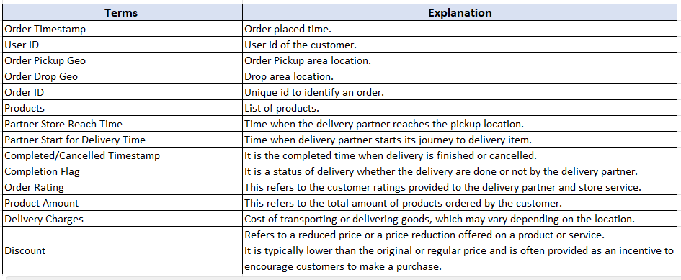
We are provided with the following data dictionary:

Slide 4
Overall Gist
We have the previously mentioned data dictionary with detailed information of all the orders.
On the basis of it, we will analyse the key insights around various levels.
Our objective would be to do the following major analysis-
1. Order Level Analysis
2. Completion Rate Analysis
3. Customer Level Analysis
4. Delivery Analysis

Slide 5
Order Level Analysis

Slide 6
By the analysis of order level distribution at slots and delivery area level, we find that the maximum number of orders are placed in either afternoon or morning while if we want to analyze the orders in terms of delivery area, HSR Layout and ITI Layout get the maximum orders.
So, if Freshco wants to do more business in terms of delivery it can focus on how to expand the business in areas where less orders are placed like Bomannahali – MicoLayout, Harlur, Whitefield etc. and do some marketing techniques in order to grow there as well.

Slide 7
For the time slots, late night and night have lowest order counts which means something needs to be done in this part as well like increasing the number of delivery partners at night, giving some coupons to attract the users and giving better experience to their customers at night time too.

Slide 9
From the chart of areas having highest increase in monthly orders(January to September), we can analyze that HSR Layout, ITI Layout and Harlur have shown decent growth in terms of orders while areas like Banashankari Stage 2 showed no growth so some strategies need to be decided for the areas having no growth on how to expand the order count in these areas.
Another thing to notice is that areas like Kundlu have decreasing growth which means there is a need to find out why these areas have negative growth and how to resolve it.

Slide 11
From the pivot chart of delivery charges as a percentage of product amount at slot and month level, we can analyze that late night and night have highest delivery charges and that too mostly from January to April.
The delivery charges are lowest mostly in September except for late night slots.

Slide 13
From the pivot chart of discount as a percentage of product amount at slot and month level, we can analyze that August month shows the highest discount in all the slots while in terms of slots, late night has the lowest discount in all the months. Maybe the discount is due to the more number of holidays or festivals in August like Rakshabandhan, Independence Day etc. which in turn can impact the overall revenue and decrease it.

Slide 15
From the pivot chart of discount as a percentage of product amount at drop area and slot level, we can analyze that the maximum discount percentage is in areas like Jayanagar, Bellandur etc. at evening and late night.

Slide 16
Completion Rate Analysis
6.0 Completion Rate at Slot Level
Count of Order ID | Column Labels
Row Labels | NO | YES/Completion Rate
Afternoon | 0.25% | 99.75%
Evening | 0.30% | 99.70%
Late Night | 0.63% | 99.37%
Morning | 0.48% | 99.52%
Night | 0.71% | 99.29%
Grand Total | 0.45% | 99.55%

Slide 17
6.1 Completion Rate at Day Level
Count of Order ID | Column Labels
Row Labels | NO | YES/Completion Rate
Monday | 0.26% | 99.74%
Tuesday | 0.45% | 99.55%
Wednesday | 0.51% | 99.49%
Thursday | 0.34% | 99.66%
Friday | 0.66% | 99.34%
Saturday | 0.76% | 99.24%
Sunday | 0.14% | 99.86%
Grand Total | 0.45% | 99.55%

Slide 18
6. Completion Rate at Slot vs Day Level
From the tables listed above in the previous slides we could find out that the total completion rate at slot and day level is same.
The completion rate for Sundays are the highest and at slot level the completion rate for afternoon is the highest.

Slide 19
7. Completion Rate at Drop Area Level
Count of Order ID | Column Labels
Row Labels | NO | YES/Completion Rate
Akshaya Nagar | 0.00% | 100.00%
Arekere | 0.00% | 100.00%
Banashankari Stage 2 | 0.00% | 100.00%
Bannerghatta | 0.00% | 100.00%
Basavanagudi | 0.00% | 100.00%
Bellandur - Off Sarjapur Road | 0.00% | 100.00%
Bellandur, APR | 0.00% | 100.00%
Bellandur, Ecospace | 0.00% | 100.00%
Bellandur, ETV | 50.00% | 50.00%
Bellandur, Green Glen | 0.75% | 99.25%
Bellandur, Sakara | 0.00% | 100.00%
Bellandur, Sarjapur Road | 0.00% | 100.00%
Bilekahalli | 0.00% | 100.00%
Binnipet | 0.00% | 100.00%
Bomannahali - MicoLayout | 0.73% | 99.27%
Bommanahalli | 1.92% | 98.08%
Brookefield | 0.00% | 100.00%
BTM Stage 1 | 2.86% | 97.14%
BTM Stage 2 | 0.00% | 100.00%
Challagatta | 0.00% | 100.00%
Cox Town | 100.00% | 0.00%
CV Raman Nagar | 0.00% | 100.00%
Devarachikanna Halli | 0.00% | 100.00%
Doddanekundi | 0.00% | 100.00%
Domlur, EGL | 25.00% | 75.00%
Frazer Town | 0.00% | 100.00%
Harlur | 0.31% | 99.69%
HSR Layout | 0.40% | 99.60%
Indiranagar | 12.50% | 87.50%
ITI Layout | 0.41% | 99.59%
Jayanagar | 0.00% | 100.00%
JP Nagar Phase 1-3 | 0.00% | 100.00%
JP Nagar Phase 4-5 | 0.00% | 100.00%
JP Nagar Phase 6-7 | 0.00% | 100.00%
JP Nagar Phase 8-9 | 0.00% | 100.00%
Kadubeesanhali, Prestige | 0.00% | 100.00%
Kadubeesanhali, PTP | 0.00% | 100.00%
Koramangala, Ejipura | 0.63% | 99.38%
Kudlu | 0.58% | 99.42%
Kumaraswamy Layout | 0.00% | 100.00%
Mahadevapura | 0.00% | 100.00%
Manipal County | 1.25% | 98.75%
Marathahalli | 33.33% | 66.67%
Pattandur | 0.00% | 100.00%
Richmond Town | 0.00% | 100.00%
Sarjapur Road | 0.00% | 100.00%
Victoria Layout | 0.00% | 100.00%
Vimanapura | 0.00% | 100.00%
Viveka Nagar | 14.29% | 85.71%
Whitefield | 100.00% | 0.00%
Wilson Garden, Shantinagar | 0.00% | 100.00%
Yemalur | 0.00% | 100.00%
Grand Total | 0.45% | 99.55%

Slide 20
From the pivot table of Completion Rate at Drop Level, we can find out that almost most of the delivery areas have completion rate of 100%
Some areas like Cox Town need to be looked upon since they have zero completion rate.

Slide 21
8. Completion rate at number of products ordered level
Row Labels | Count of No. of products against every order
NO | 0.45%
YES/Completion Rate | 99.55%
Grand Total | 100.00%

Slide 22
From the pivot chart of completion rate at number of products ordered level, we could find out that the completion rate is very high and in accordance with the number of products ordered.

Slide 23
9. Any pattern observed ?
From each of the level on the basis of which we calculated the completion rate we could find that it is almost 99.55% with very slight difference only which means almost every order gets completed successfully without any cancellations.
Thus, high completion rate at every level means that completion rate is one of the business metrics which doesn’t need much changes from our side.

Slide 24
Customer Level Analysis
10. Completion Rate at source level
Count of Completion Flag | Column Labels
Row Labels | NO | YES/Completion Rate | Grand Total
Facebook | 0.05% | 11.42% | 11.47%
Google | 0.11% | 23.33% | 23.43%
Instagram | 0.07% | 12.13% | 12.20%
Offline Campaign | 0.07% | 12.47% | 12.54%
Organic | 0.11% | 29.16% | 29.27%
Snapchat | 0.05% | 11.04% | 11.09%
Grand Total | 0.45% | 99.55% | 100.00%

Slide 25
Sources like Google and Organic have the highest completion rate which means they bring out highest number of orders while snapchat brings the lowest count of orders. So, some new level of marketing can be done for other sources as well so that they attract more number of customers.

Slide 26
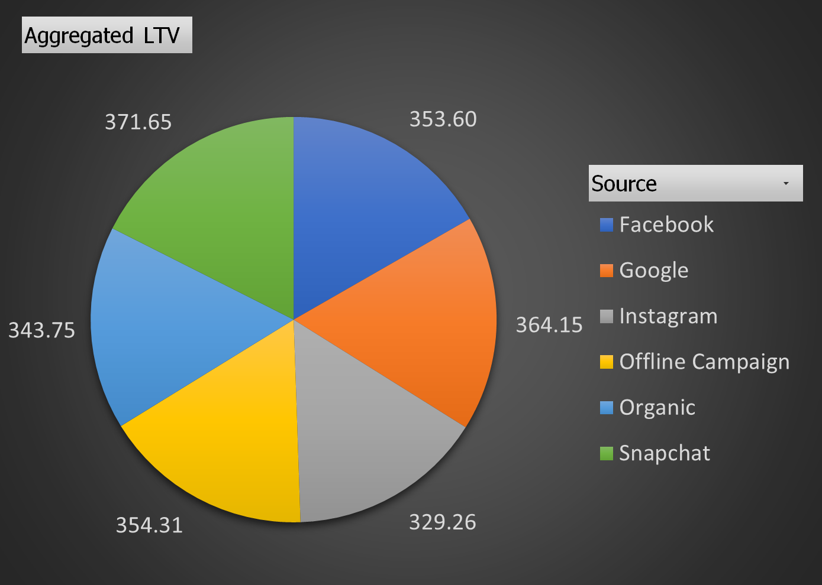
12. Aggregated LTV at customer acquisition source level.

Slide 27
The aggregated LTV of snapchat and google are the highest, and even the other acquisition sources LTV’s are also similar only.

Slide 28
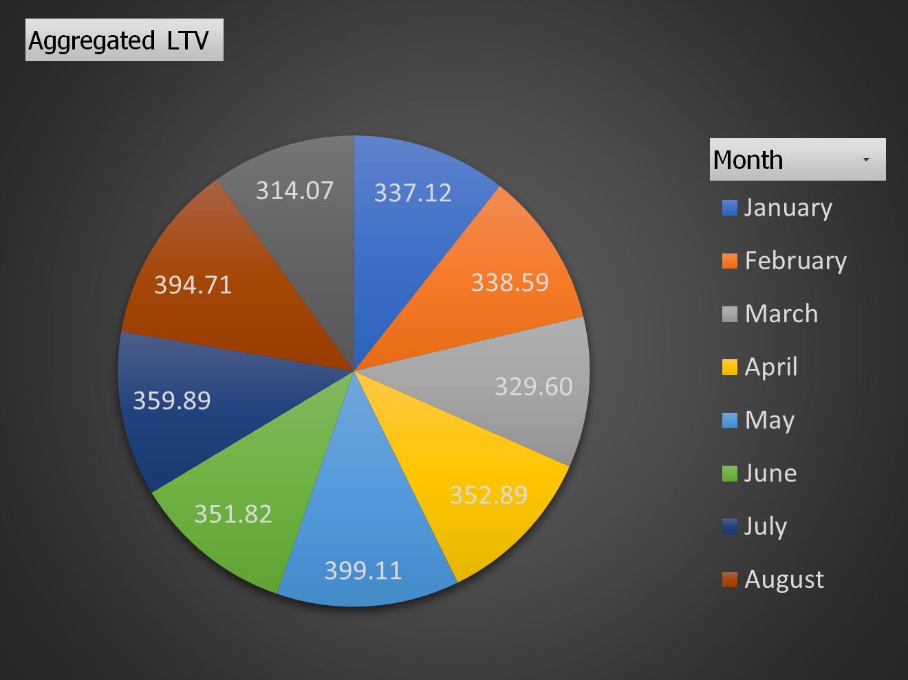
13. Aggregated LTV at acquisition month level

Slide 29
Aggregated LTV every month is different which suggests that the customer behavior changes accordingly. May and august have the highest aggregated LTV.
By comprehending these trends, and doing some marketing techniques the customer lifetime value can be increased.

Slide 30
14. Average Revenue(Product amount after discount) per order at different customer acquisition source level
Row Labels | Average Revenue
Facebook | 329.4898508
Google | 344.0300249
Instagram | 302.8781819
Offline Campaign | 327.8576924
Organic | 324.7925794
Snapchat | 345.5940061
Grand Total | 329.8572246

Slide 31
15. Average Revenue(Product amount after discount) per order at acquisition month level
Row Labels | Average of Revenue
January | 333.5606659
February | 336.2614041
March | 327.2023545
April | 349.8155035
May | 380.7840627
June | 344.8986454
July | 340.6658927
August | 312.639463
September | 281.6011416
Grand Total | 329.8572246

Slide 32
16. Any pattern in order rating across slots, number of items placed, delivery charges, discount?
Orders placed during afternoon and morning are rated high compared to other time slots
No Dependence - Rating is not much dependent on the number of items

Slide 33
Order Rating across delivery charges vs discount charges
No dependence
No dependence

Slide 34
Delivery Analysis
Delivery time at slot level
Delivery time at month level

Slide 35
Delivery time is less in late night and at night slots compared to other slots.
Delivery time is more in may and april month whereas february month got the fastest deliveries.
Delivery charges are highest in late night while the charges are lowest in morning slots.
Delivery charges are higher if the distance of the delivery area from pickup point is more.

Slide 36
Delivery time at weekend/weekdays

Slide 37

From the chart we can easily interpret that deliveries take more time during weekends compared to weekdays.
The delivery time is different for various delivery areas mainly due to a lot of reasons like traffic, more numbers of orders placed, more distance area etc. To maximize the delivery time, all the factors need to be thought of and then some strategy needs to be applied.

